Slide 1

Université de Mostaganem — Dr. Madani BELACEL
TIC COURSE 04
Word Processing: Microsoft Word
Dr. BELACEL Madani
Année universitaire 2026-2027 / Academic Year 2026-2027
Université de Mostaganem - Département Mathématiques et Informatique

Slide 2
Université de Mostaganem — Dr. Madani BELACEL
Course Outline
▪ 1. What Is Word Processing?
▪ 2. The Word Interface
▪ 3. Text Formatting
▪ 4. Page Layout
▪ 5. Objects: Tables, Images, Shapes
▪ 6. Checking and Reviewing
▪ 7. Printing and Exporting

Slide 3
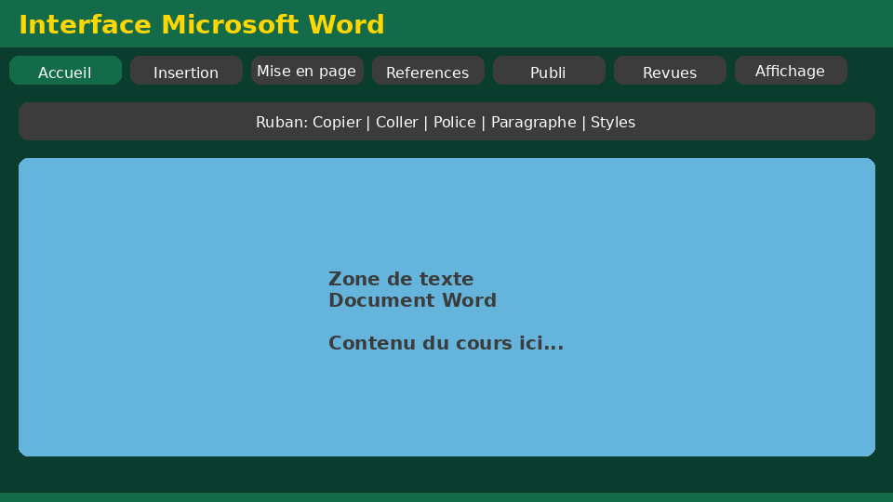
Université de Mostaganem — Dr. Madani BELACEL
Section 1
What Is Word Processing?

Slide 4
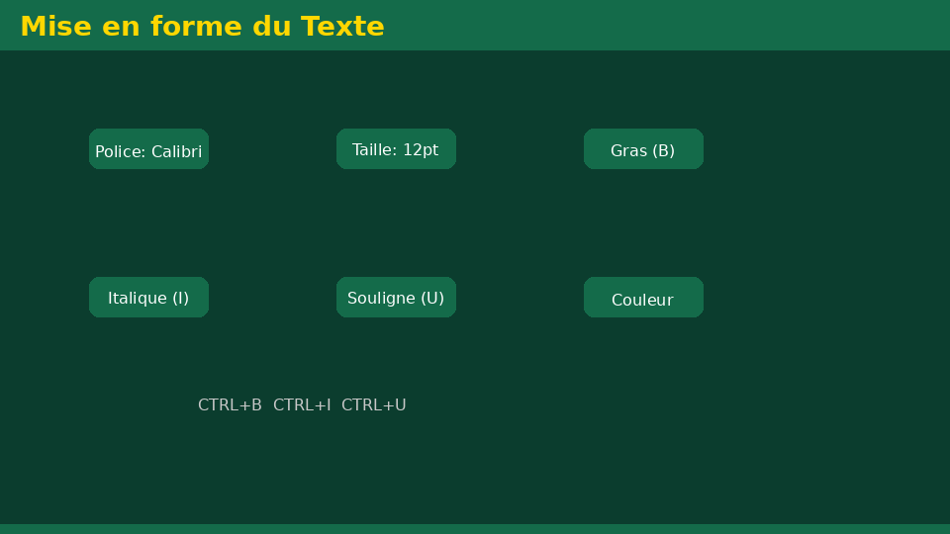
Université de Mostaganem — Dr. Madani BELACEL
1 - What Is Word Processing?
▪ Software for creating and formatting text documents.
▪ Advantages over paper: easy editing, correction, duplication.
▪ Word is the world's most used editor (.docx format).
▪ Alternatives: LibreOffice Writer, Google Docs.

Slide 5
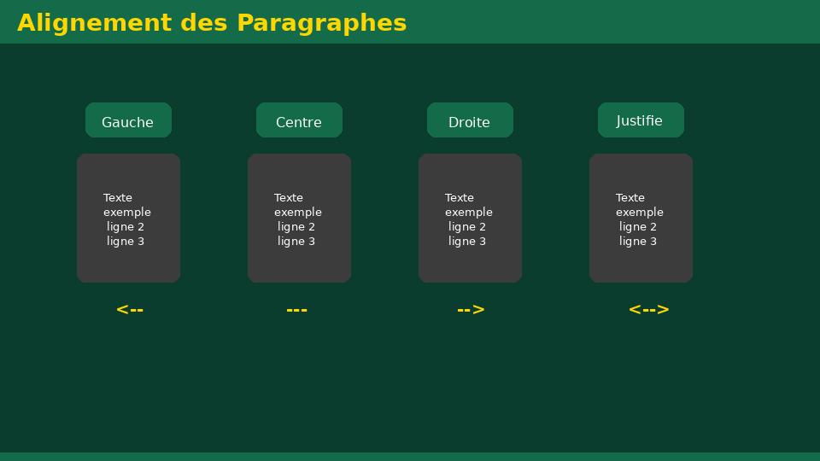
Université de Mostaganem — Dr. Madani BELACEL
Section 2
The Word Interface

Slide 6
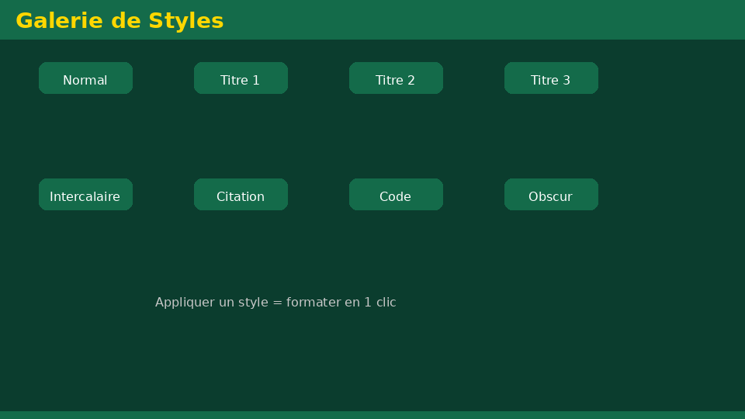
Université de Mostaganem — Dr. Madani BELACEL
2 - The Word Interface
▪ Ribbon: Home, Insert, Layout, References tabs...
▪ Editing area with rulers and scroll bars.
▪ Status bar: page count, word count, language.
▪ Quick Access Toolbar: save, undo, redo.

Slide 7
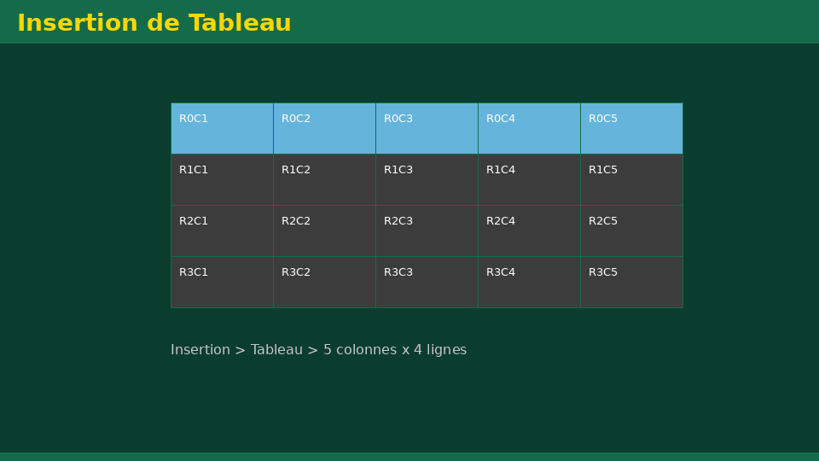
Université de Mostaganem — Dr. Madani BELACEL
Section 3
Text Formatting

Slide 8
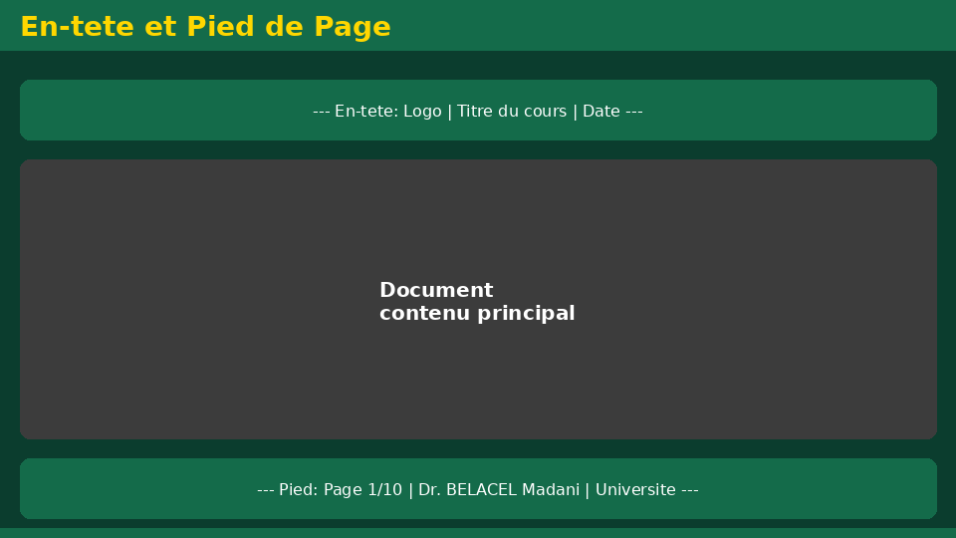
Université de Mostaganem — Dr. Madani BELACEL
3 - Text Formatting
▪ Font: type, size, bold, italic, underline, color.
▪ Alignment: left, center, right, justified.
▪ Bulleted and numbered lists.
▪ Line spacing and paragraph spacing.
▪ Format Painter: copying formats.

Slide 9
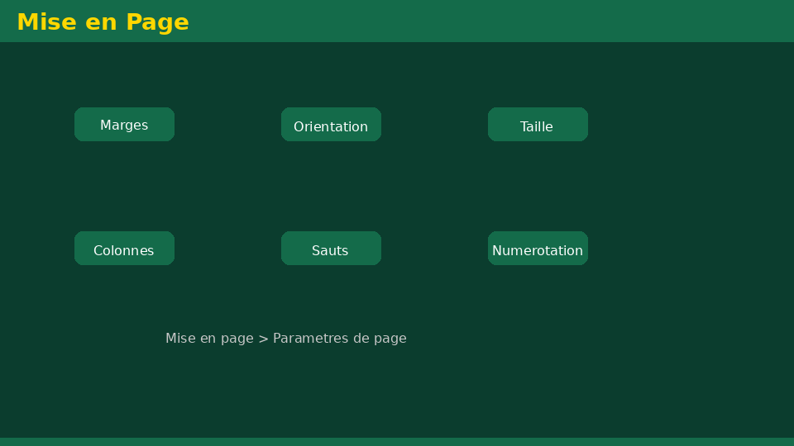
Université de Mostaganem — Dr. Madani BELACEL
Section 4
Page Layout

Slide 10
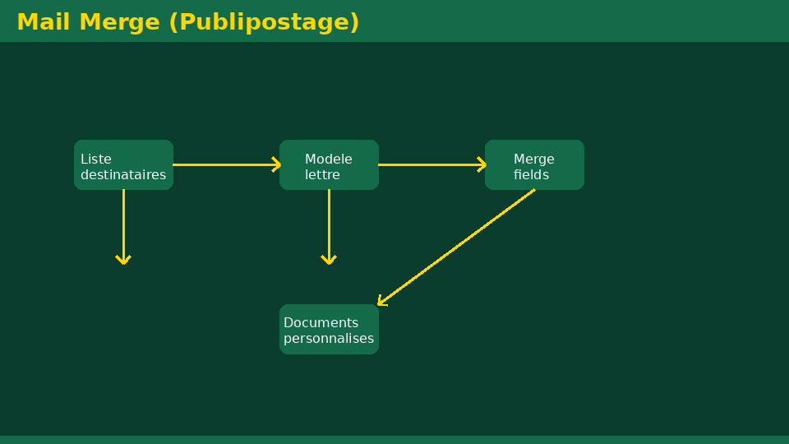
Université de Mostaganem — Dr. Madani BELACEL
4 - Page Layout
▪ Margins, orientation (portrait/landscape), A4 paper size.
▪ Headers and footers: titles, page numbers, date.
▪ Inserting page and section breaks.
▪ Columns and text boxes.
▪ Themes and quick styles.

Slide 11
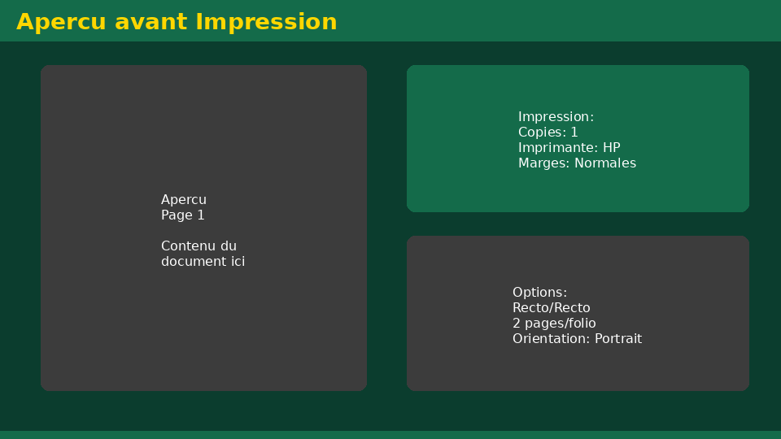
Université de Mostaganem — Dr. Madani BELACEL
Section 5
Objects: Tables, Images, Shapes

Slide 12
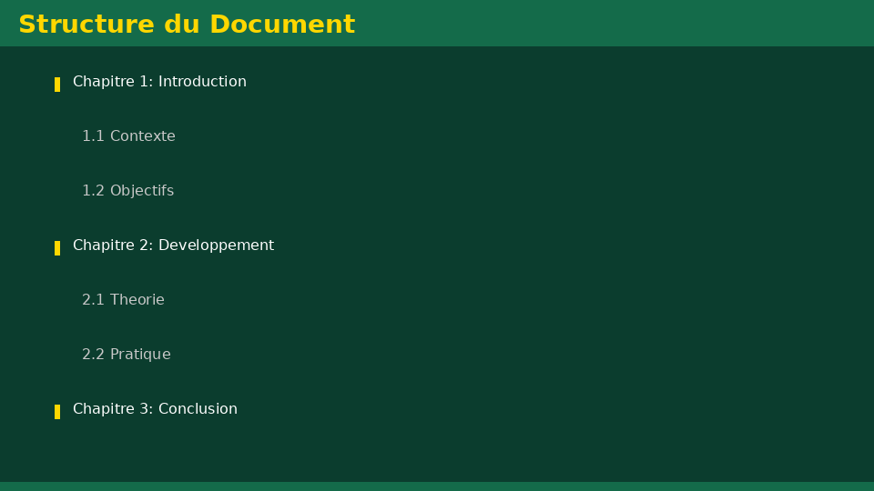
Université de Mostaganem — Dr. Madani BELACEL
5 - Objects: Tables, Images, Shapes
▪ Insert a table: rows, columns, merge, borders.
▪ Pictures: insert, resize, text wrapping.
▪ Shapes, SmartArt and charts.
▪ Symbols and mathematical equations.

Slide 13
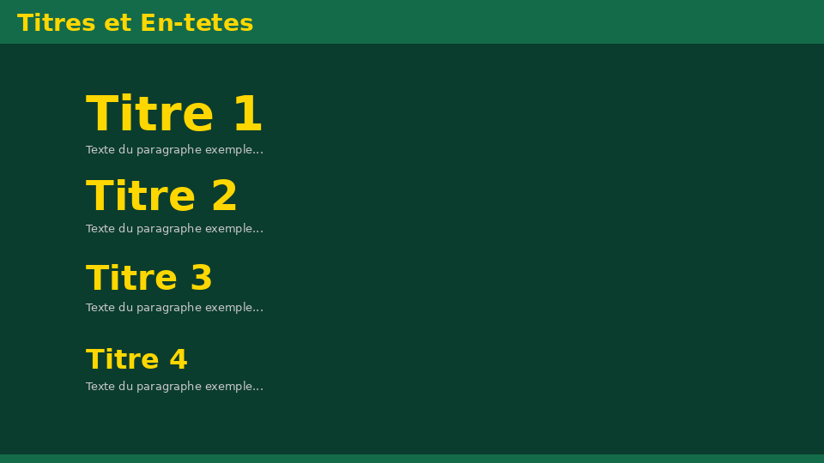
Université de Mostaganem — Dr. Madani BELACEL
Section 6
Checking and Reviewing

Slide 14
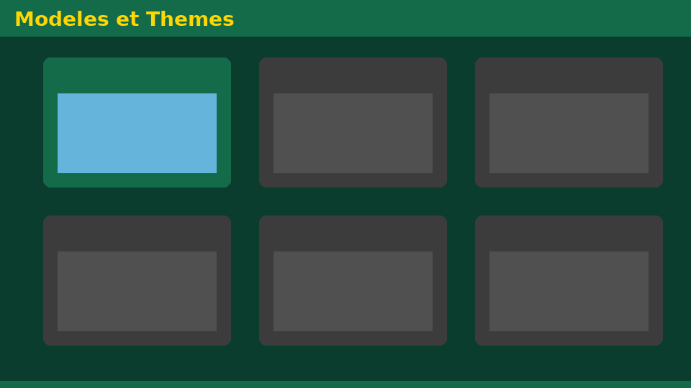
Université de Mostaganem — Dr. Madani BELACEL
6 - Checking and Reviewing
▪ Spelling and grammar checking (F7).
▪ Synonyms: the thesaurus.
▪ Find and replace (Ctrl+F, Ctrl+H).
▪ Comments and track changes.
▪ Document comparison.

Slide 15
Université de Mostaganem — Dr. Madani BELACEL
Section 7
Printing and Exporting

Slide 16
Université de Mostaganem — Dr. Madani BELACEL
7 - Printing and Exporting
▪ Print preview: check the layout first.
▪ Options: number of copies, selected pages, duplex.
▪ Export to PDF: universal read-only format.
▪ Saving: .docx, .doc (compatibility), templates .dotx.

Slide 17
Université de Mostaganem — Dr. Madani BELACEL
Practical Interest
▪ Write professional reports, theses and CVs.
▪ Create academic documents that meet standards.
▪ Produce minutes, letters and certificates quickly.
▪ Export to PDF to share safely without edits.

Slide 18
Université de Mostaganem — Dr. Madani BELACEL
Self-Assessment (MCQ)
1. Which key starts spell checking?
a) F1
b) F7
c) F12
2. The header is located:
a) At the bottom of the page
b) At the top of the page
c) In the right margin
3. To justify text use:
a) Ctrl+J
b) Ctrl+E
c) Ctrl+U

Slide 19
Université de Mostaganem — Dr. Madani BELACEL
Conclusion
▪ Word easily structures, formats and corrects your documents.
▪ Styles and page layout ensure clean documents.
▪ PDF export secures final sharing.
▪ Next course: Microsoft Excel spreadsheets.

Slide 20
Université de Mostaganem — Dr. Madani BELACEL
References
- Microsoft Support - Word Guide.
- "Word 2019 for Dummies", Wiley.
- ICT Course materials, University of Mostaganem.
- Office community forums.

Slide 21
Université de Mostaganem — Dr. Madani BELACEL
Thank you for your attention!
Questions?
Dr. BELACEL Madani

